Slide 1
Marketing Your Café
The Café LA Way

Slide 2
Marketing
Marketing is essential in keeping any business afloat. It helps build a relationship of trust and understanding between a business and its customers.

Slide 3
Marketing building blocks of success
Initiating a marketing campaign in your business and keeping your customers engaged in your brand gives them a sense of belonging.
How can we achieve this in Café LA?
1. Keep it
Fresh
2. Create
Excitement
3. Get
Everyone
Involved

Slide 4
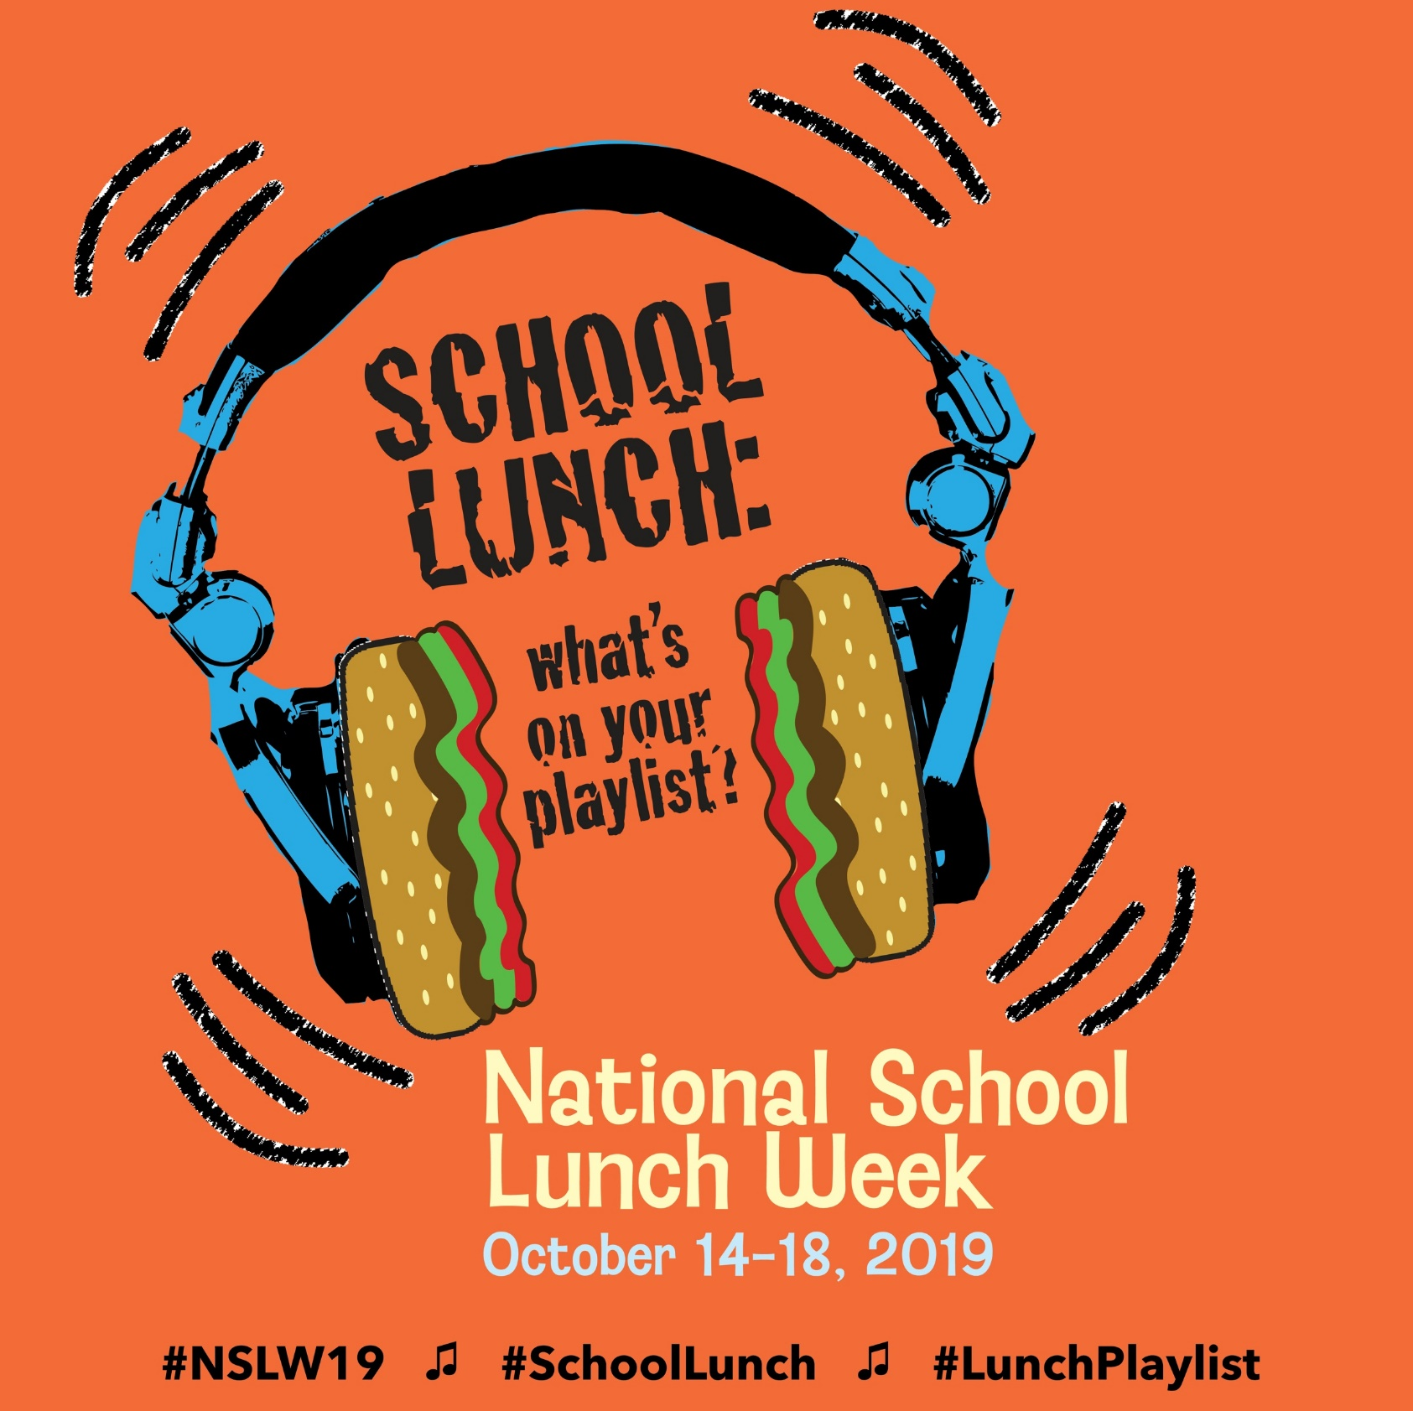
National campaigns
National School
Breakfast Week
National School
Lunch Week

Slide 5
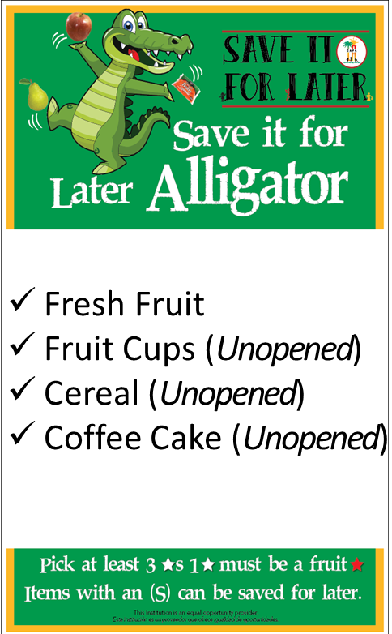
Lausd campaigns
Taste It
DON’T
Waste It!

Slide 6
Celebrations and holidays

Slide 7
Celebrations and holidays
What about fruit of the day?
Vegetable of the week/day?
Featured Entrée/New Menu Items
Joke of the Week (Use a chalkboard or whiteboard available)
Other National Holidays or School Campaigns
Dr. Seuss Week
Cinco de Mayo
Spirit Week
Homecoming Week
Sports Celebrations (School or Seasonal)

Slide 8
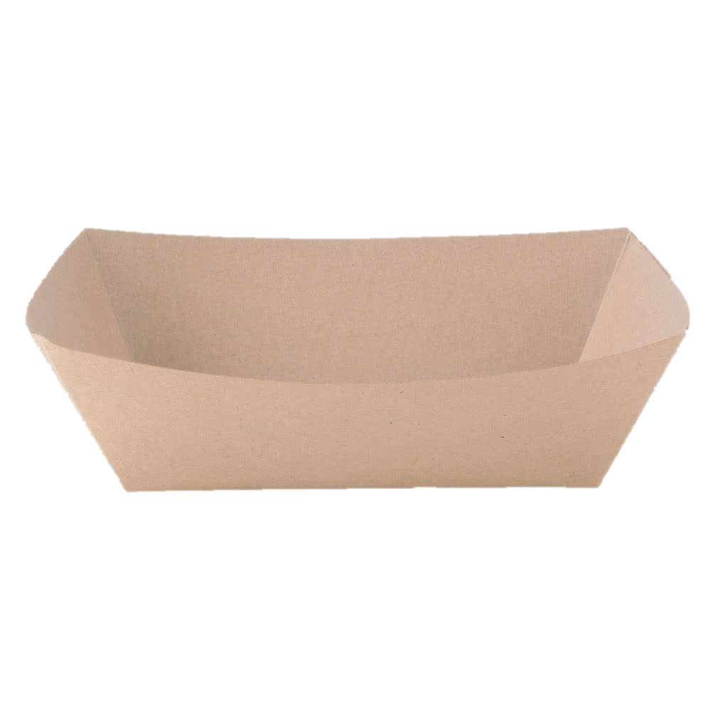
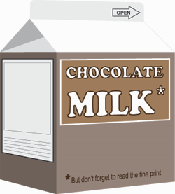
5 campaign w’s
What is the goal?
Where will we offer it?
Who’s involved?
When will it work best?
Why are we doing this?

Slide 9
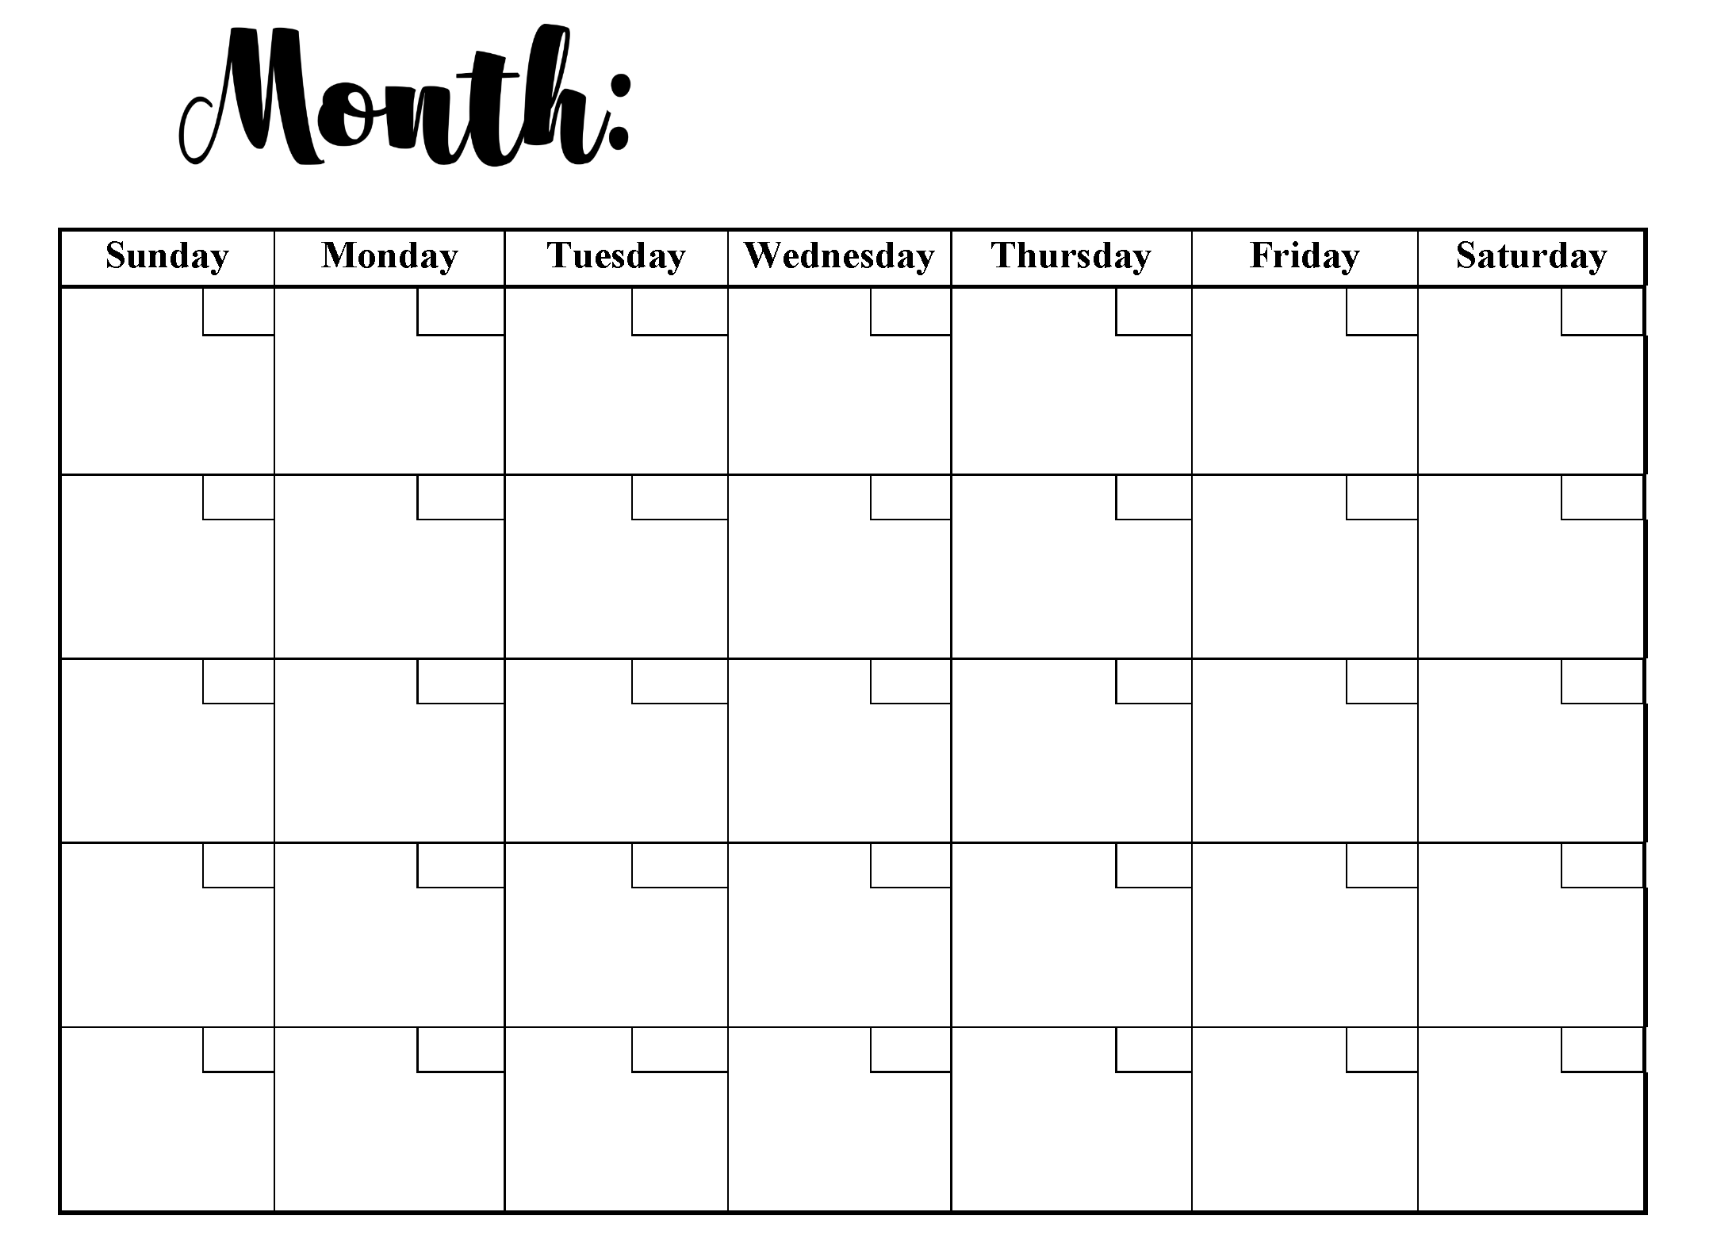
CAMPAIGN Breakout activity
Search for months with celebratory/theme days
Pick a theme: Daily/Monthly/National Food Day
Name your campaign
Write action steps using 5 W’s worksheet
Present your campaign

Slide 10
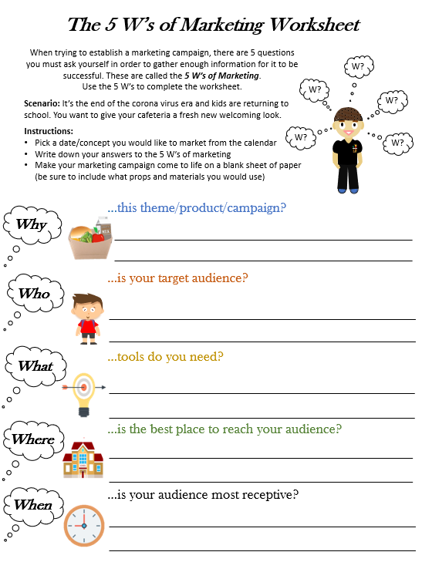
Use the 5 W’s of Marketing Worksheet to work out your plan and state the Why?, Who?, What?, Where?, and When? of your marketing plan.

Slide 11
Who are our customers?
1995-2012
The influencers of tomorrow
Determined
Inependent
Competitive
Stressed
Distracted
Digital Saavy and Connected

Slide 12
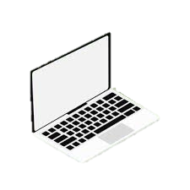
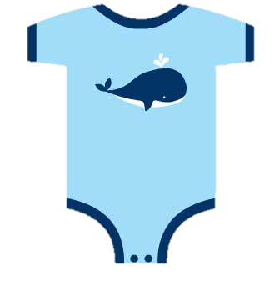
Z
A
Generation z
Generation Alpha
8 year olds-23 years old
Newborns-7 years old

Slide 13
How to market café la to gen-z
1. Communicate In A Personal, Relatable Way
Ask for their personal feedback on products; use words they would understand.
Do you Like Pizza?
A. Pizza gives me life
B. I dabble
C. Not really…

Slide 14
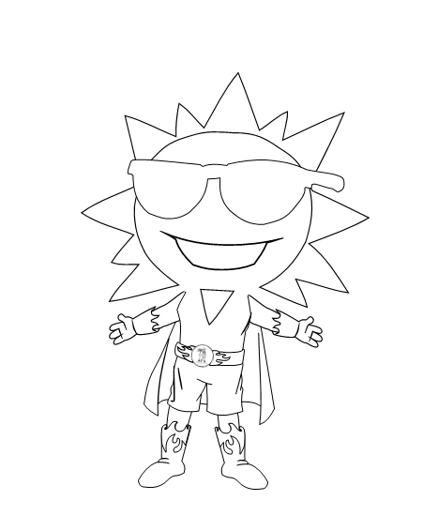
How to market café la to gen-z
2. Generate Loyalty Through Meaningful Interactions
GenZ value brand loyalty more than others. Host games, competitions, and events.

Slide 15
How to market café la to gen-z
Now that your cafeteria has been brightened up with a new ambiance, you should expect to see more students in your kitchen. This means you will need to adjust your forecasted numbers in order to accommodate for the increased participation.

Slide 16
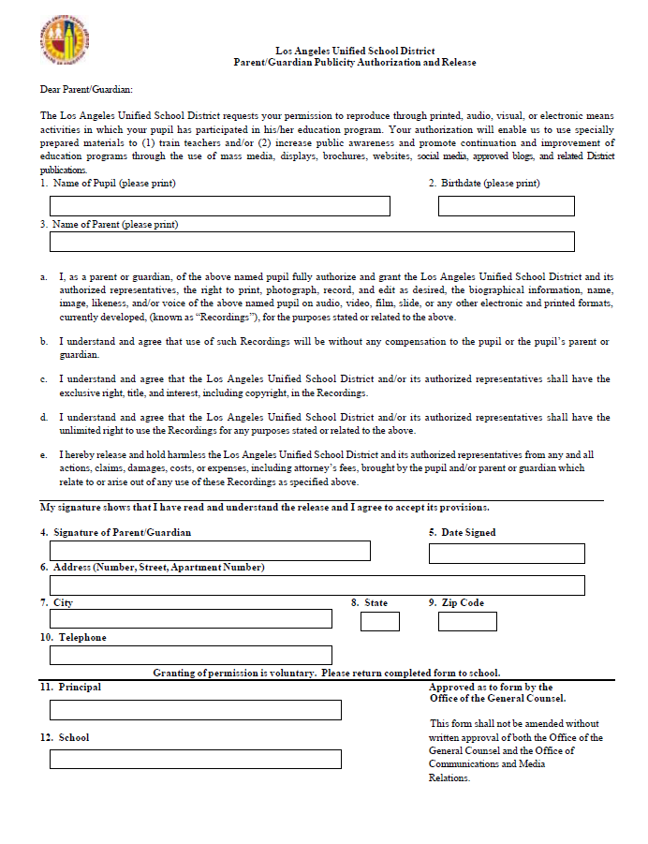
Social media
Social media is one of the best platforms where you can engage your customers. Some organizations use short videos and other humor-laden tricks to engage their customer base.
Note: All photos taken must be accompanied by a media release for all individuals (adults and children) in the photo.

Slide 17
Food Services Division Social media Accounts
@cafeLA_lausd
@cafeLA_lausd
@Café-LA_LAUSD

Slide 18
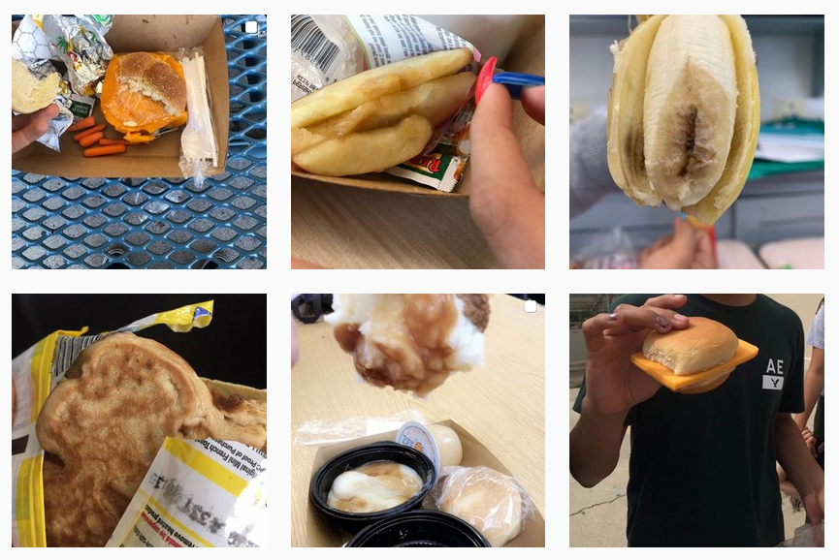
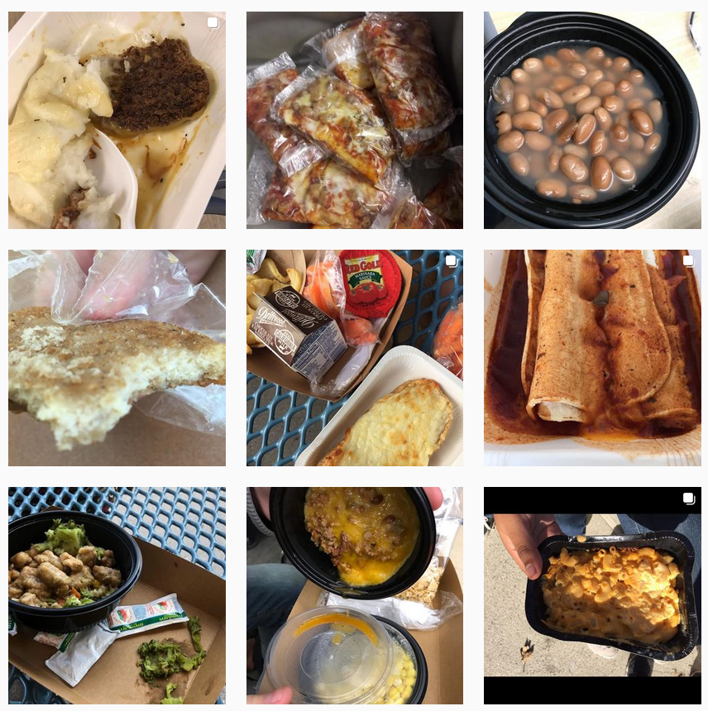
Be cautious on social media platforms
Understand That GenZ Uses Social Networks Differently
GenZ has a short attention span and is not scared to share their opinion.

Slide 19
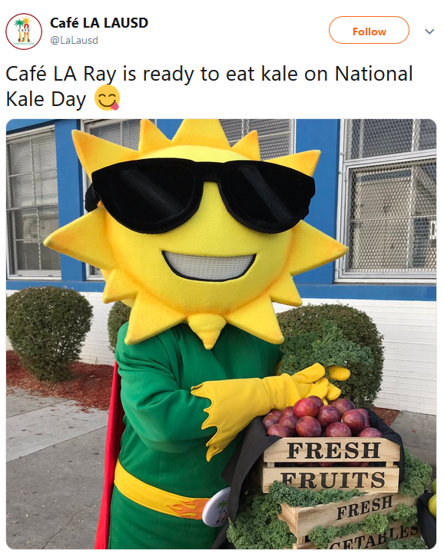
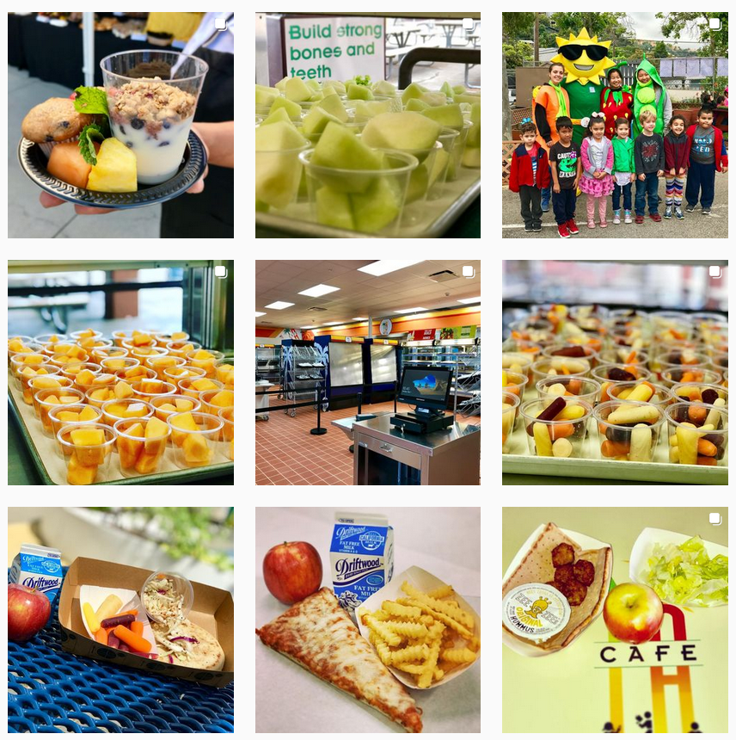
Make gen-z work for your cafe
Share real-life moments on social media.

